Slide 1
Module 1 Data Fabric Overview
1
Notes:
Instructor Notes
Student Notes

Slide 2
This module focuses on enabling you to do the following:
Explain the value of the Data Fabric solutions
Describe NetApp solutions for the hybrid cloud
Describe NetApp Cloud Data Services and how they enable customers to accelerate their cloud workloads
Describe the tools and APIs for management of data in a hybrid cloud
Get started with Amazon Web Services (AWS) and Microsoft Azure environments: specifically, run basic Windows PowerShell commands for AWS, Azure, and NetApp
Notes:
Instructor Notes
Note that some of this information is learned via the PowerPoint slides, like the data fabric vision and the Cloud Data Services. The others such as creating AWS users and PowerShell are learned via the lab exercises.
Student Notes

Slide 3
Data Fabric
Notes:
Instructor Notes
Student Notes

Slide 4

The Data Fabric Powered by NetApp
Data Fabric enables customers with a shared set of secure data services so that they can manage, access, and protect data where it is needed most. Customers can respond and innovate faster and gain the freedom to make the best decisions for their businesses.
Notes:
Instructor Notes
Student Notes

Slide 5

How Does the Data Fabric Powered by NetApp Work?
Creates
Freedom
Mobility
Speed
Cloud Service Providers
Hyperscale Cloud Providers
Cloud Service Providers
Hyperscale Cloud Providers
Data
Private Cloud
Private Cloud
Realize the full potential of the hybrid cloud.
Notes:
Instructor Notes
Student Notes
Customers’ data is often in several locations and disjointed and requires separate management, maintenance, and backup solutions. The Data Fabric powered by NetApp enables customers to access and manage their data no matter where it exists.

Slide 6


Data Fabric Defined
NetApp is a cloud data services and infrastructure company
Dynamic Data Portability
Control and Choice
Connects different data management environments across disparate clouds into a cohesive, integrated whole
Helps organizations maintain control and choice in how they manage, secure, protect, and access their data across the hybrid cloud
Notes:
Instructor Notes
Purpose of this slide: Introduce the concept of Data Fabric and describe how it addresses the challenges of managing data in a hybrid cloud architecture.
Key points: Data Fabric is NetApp’s architecture for hybrid cloud. It seamlessly connects different data management environments across disparate clouds into a cohesive, integrated whole. It helps organizations maintain control and choice in how they manage, secure, protect, and access their data across the hybrid cloud, no matter where it is.
Student Notes Data Fabric is the NetApp vision for the future of data management. Data Fabric is also the NetApp technology architecture for the hybrid cloud. A Data Fabric seamlessly connects different data management environments across disparate clouds into a cohesive, integrated whole. Organizations maintain control and choice in how they manage, secure, protect, and access their data across the hybrid cloud, no matter where it is. IT has the flexibility to choose the right set of resources and the freedom to change them whenever needed.

Slide 7
Solutions for the Hybrid Cloud
If the fabric has more threads, it becomes stronger, and therefore IT has more solutions with which to solve business problems
Notes:
Instructor Notes
Student Notes

Slide 8
NetApp Solutions for the Hybrid Cloud
NetApp enables customers to easily store, manage, and move data in a hybrid Cloud environment by providing the following:
Storage
In-built technologies in ONTAP software
Software as a service (SaaS) offerings from NetApp Cloud Central
A suite of management and analytics tools and APIs
Notes:
Instructor Notes
The purpose of this slide is to provide a high-level view of all the things that we will talk about in the rest of the slides.
Storage
private cloud, public cloud, close to the cloud
File Storage, Block Storage and Object Storage
In-built technologies in ONTAP
SnapMirror, SnapVault, Fabric Pool, storage efficiency, multiprotocol support
Interoperability with multiple NetApp products and with major cloud providers
SaaS offerings from NetApp Cloud Central
Cloud Volumes Service, Cloud Sync Service, NetApp Data Availability Service etc.
A Suite of management and Analytics tools and APIs
OnCommand Cloud Manager, Cloud Insights
Student Notes

Slide 9
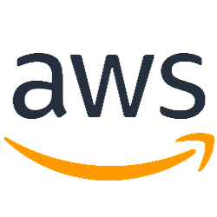
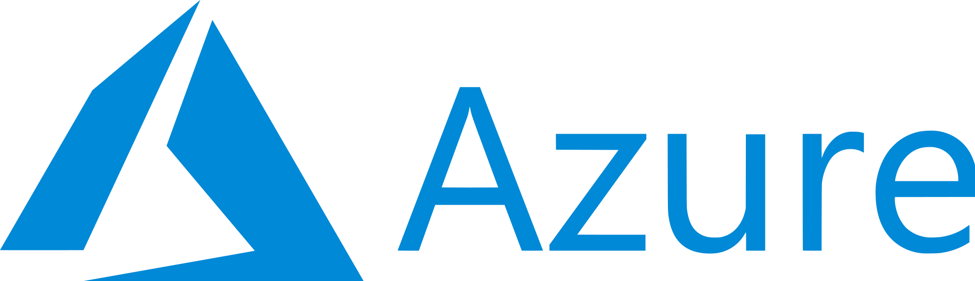
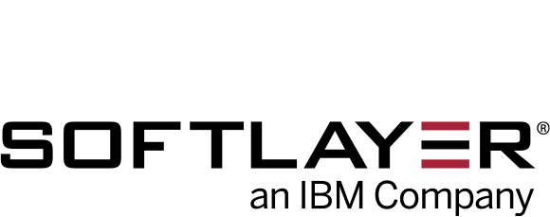

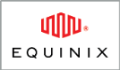
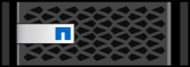
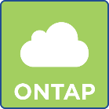
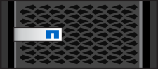
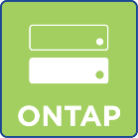
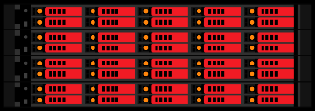
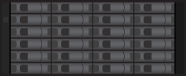
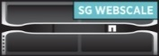
Data Fabric Deployment Models
Colocation
Hybrid cloud is the new normal for enterprises.
SnapMirror Technology Connected
Public Cloud
Dedicated Link
NetApp Storage
NetApp Private Storage
Cloud Storage
Assume the following:
Encryption
Compression
Deduplication
Security
Multiple endpoints
Data Center
SolidFire Cluster
FAS System
StorageGRID Solution
ONTAP Select Software
9
Notes:
Instructor Notes
Student Notes
Here is an example of how NetApp systems are used to create the endpoints of a Data Fabric within a hybrid cloud architecture.
In its simplest form, a hybrid cloud deployment can consist of a FAS array in the corporate data center and NetApp Cloud Volumes ONTAP software in AWS or Azure. SnapMirror software replicates data from one location to the other. A hybrid cloud can also connect colocation-managed or dedicated services with cloud resources. For data center private cloud or service provider cloud, the FAS system could be a FlexPod converged infrastructure or a standalone FAS system.

Slide 10
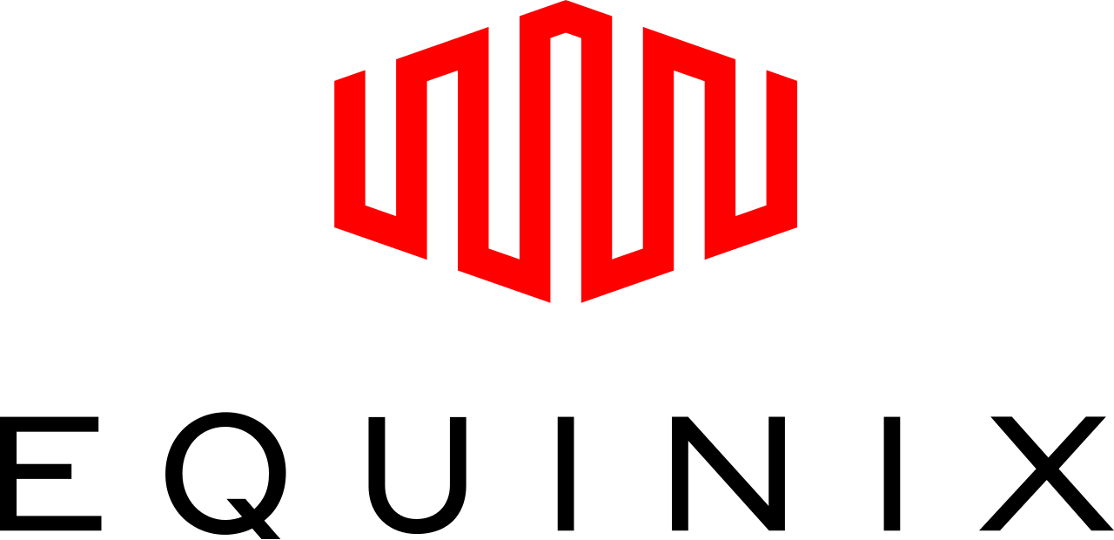
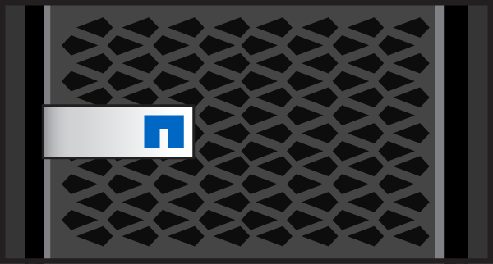
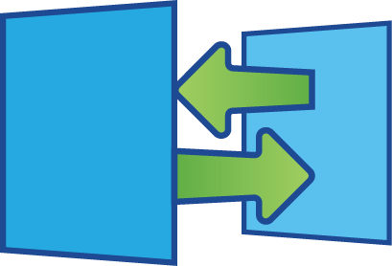
Multiple Cloud Choice with NetApp Private Storage (NPS)
1
Data Sovereignty
2
Multicloud Choice
3
Performance
Install dedicated NetApp storage in an Equinix cabinet and connect to Equinix Cloud Exchange for data sovereignty
Replicate the customer’s data to “next to” cloud compute resources
Access multiple cloud providers from the controlled data source
Experience low latency (2 ms and less) through cloud proximity and 10-Gigabit Ethernet (10-GbE) connectivity for demanding applications and use cases
Switch between cloud providers without moving data over a WAN
GCP
Equinix Cloud Exchange
WAN
Data Center
NetApp Storage
NetApp SnapMirror
NPS for Cloud
Customer On-Premises IT
Notes:
Instructor Notes
Goal of slide: Introduce the 3 key drivers or values of NPS.
For companies looking for a hybrid cloud solution, NPS for Cloud places data and compute next to the cloud,
scaling capacity, performance, and data recovery with data control.
It provides data sovereignty for organizations that are concerned about compliance and governance.
And it provides excellent performance and low latency.
Student Notes
Enable choice with multicloud connectivity:
Connect to AWS, Azure, or Google Cloud Platform through a dedicated network connection
Connect to and switch cloud providers at any time
Avoid vendor lock-in and costly data migrations
NetApp Private Storage for Cloud (NPS for Cloud) has the following minimum requirements:
NetApp storage (FAS, AFF, and SolidFire clusters)
Cisco (or other) router, firewall, and VPN concentrator
Colocation cabinet at Equinix (or other colocation facility)
Equinix Cloud Exchange or cross-connect to communication service provider (CSP)
Contract with cloud service providers
Professional services, installation, and integration

Slide 11
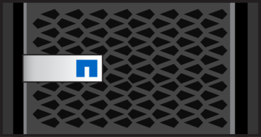

Connect Systems
Shared data transport: SnapMirror software and SnapVault software
FAS system
AltaVault
AFF system
Shared Data Transport
SolidFire cluster
ONTAP Select software
Notes:
Instructor Notes
Purpose of this slide: Define the transport layer and describe how NetApp technologies deliver a common data transport.
Key points: The transport layer provides a common data protocol that connects all platforms in the Data Fabric to seamlessly transfer data in bulk. Common data transport connects all of the components of the Data Fabric with each other and with clouds.
Student Notes The key to successfully moving data in your Data Fabric is to have a shared data protocol transport. This transport mechanism enables applications to access data where it is needed most: in a cloud, across storage tiers, or across clusters. Applications are not aware of any data movement.
With a shared data transport, systems can interoperate and move data efficiently between them by using SnapMirror replication or SnapVault backup capabilities. Not only does this transport enable interoperability, it also preserves deduplication and compression storage efficiencies. Data does not rehydrate when moving from one endpoint to another. This transport is the fastest way to move data in bulk in the fabric. It is especially important when the fabric spans WANs for hybrid cloud architectures.

Slide 12
Automatic Object Store Data Tiering
ONTAP software
Object Store Data Tiering
Private Cloud Object Store
FAS system
AltaVault
Shared Data Transport
ONTAP Select software
Object Store Data Tiering
SolidFire cluster
AFF system
Object Store Data Tiering
Local Object Stores
StorageGRID
OpenStack Swift
Ceph
Home Grown
Notes:
Instructor Notes
Purpose of this slide: Explain the importance of automatic object store data tiering in a Data Fabric.
Key points: Data has temperature – what is hot today may turn cold tomorrow. Intelligently and automatically moving data to the tier that best suits its access patterns helps optimize data availability.
Note that for AFF and ONTAP Select can also tier to the Public Cloud but for simplicity of this image only showing to StorageGrid.
Student Notes This automatic object store data tiering is implemented in ONTAP 9.2 software with the FabricPool feature. This object data tiering is not used as a backup or for disaster recovery. It is storing cool data (for example, Snapshot copies) on a more appropriate tier. ONTAP software understands the access patterns of your data and automatically moves it to the tier that best suits the observed patterns.

Slide 13
NetApp Cloud Data Services
Empowering the cloud champions

Slide 14
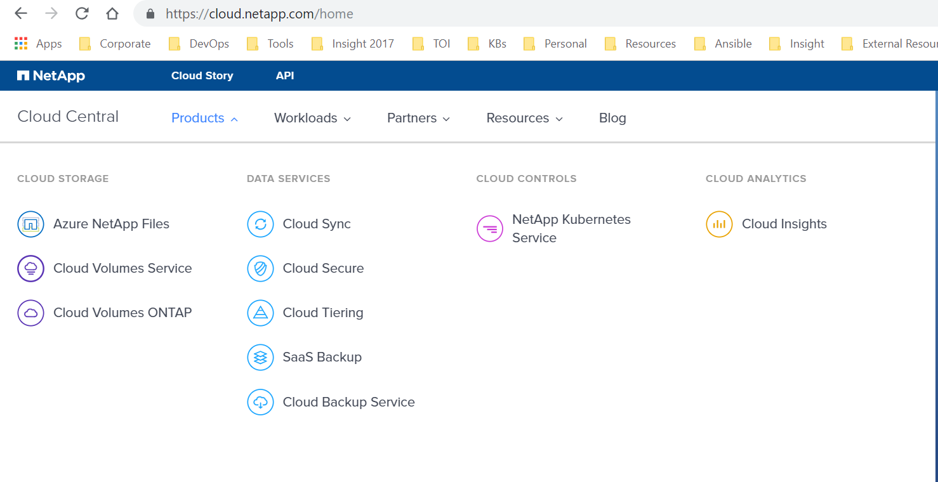
Cloud Central
https://cloud.netapp.com/home
Notes:
Instructor Notes
Whether you are an IT manager looking to operate an application in the cloud, a Data Scientist utilizing big data in the cloud, or a Developer building a new best-in-class SaaS, NetApp Cloud Data Services can provide you with enterprise-class solutions delivered by the company that developed ONTAP®, the #1 data management software in the world.

Slide 15
NetApp Cloud Data Services
Service offerings
Cloud Analytics
Cloud Insights
Cloud Controls
OnCommand Cloud Manager
APIs
NetApp Kubernetes Service
Can be used in hybrid cloud environments
Data Services
Cloud Sync Service
Cloud Tiering
Cloud Secure
SaaS Backup
Cloud Backup Service
Cloud Storage
Cloud Volumes Service
Azure NetApp Files
Cloud Volumes ONTAP
Data Location
Private or Public Cloud
AWS | Google Cloud | Azure
SaaS Application
Office 365 | Salesforce
On-Premises
Data Center | Service Provider
Notes:
Instructor Notes
Student Notes
NetApp cloud data services provide a full stack of services to deploy, run, monitor, maintain, and manage cloud services in the biggest public clouds. These services enable customers to avoid that work.
This illustration is used throughout the course to help you to visualize the cloud data services in respect to where they are typically used.
Your NetApp cloud data services journey starts with the location of your data. For example, your data could be in any of the following:
A private or public cloud like Amazon Web Services (AWS), Google Cloud, or Microsoft Azure
A SaaS application like Microsoft Office 365 or Salesforce
An on-premises data center or service provider
NetApp cloud services have many offerings, which are grouped into four categories:
Cloud Storage, which includes Cloud Volumes Service, Azure NetApp Files, and Cloud Volumes ONTAP
Data Services, which includes Cloud Sync service and SaaS Backup
Cloud Controls, which includes Cloud Manager, APIs, and NetApp Kubernetes Service
Cloud Analytics, which includes Cloud Insights

Slide 16



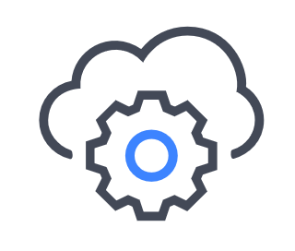
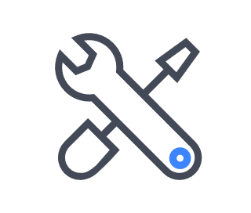

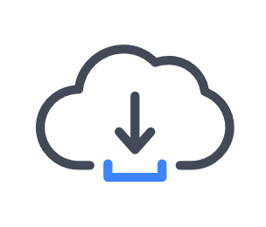
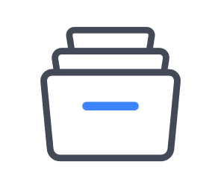
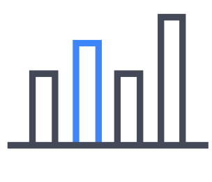
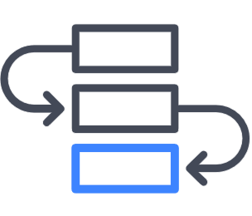
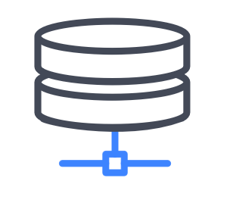
Cloud Workloads
Enterprise Workloads
SaaS App Development
Disaster Recovery
Backup & Archive
File Services
Analytics
DevOps
Database
Cloud Volumes Service
Cloud Volumes ONTAP
SaaS Backup
Notes:
Instructor Notes
Student Notes
There are many workloads that can be run in the cloud. Following are the most frequently seen:
Enterprise applications, which typically require uninterrupted, secure, and efficient operation
SaaS app development, which requires the ability to scale up at a reduced cost while staying fast and agile
Disaster recovery, which requires a cost-effective cloud secondary copy that supports seamless and quick failover and failback
Backup and archive, which requires simple and easy management of data to guard from threats or accidental deletion
File services, which require simple file access, sharing, protection, and management in any geography or scale
Analytics, which requires using data management, collaboration, and mobility services to analyze massive amounts of data
DevOps, which requires durable, high-performance, on-demand, and instant volume creation
Database, which requires an extra level of performance and protection guarantees
As you can see, each workload has specific requirements. Knowing the requirements for your workload helps you to determine the service offering that best fits your needs. Cloud Central provides guidance in choosing the best service for each of the workloads from the workloads menu.

Slide 17
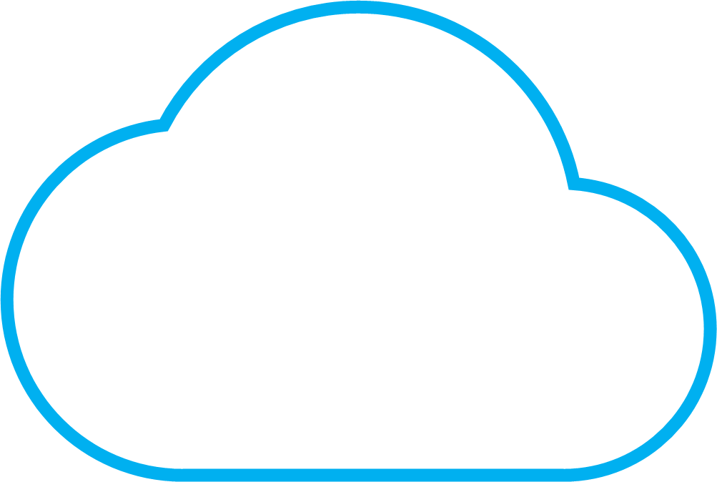
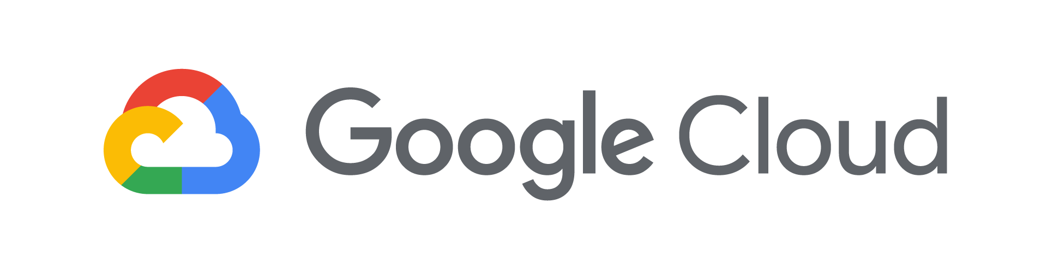
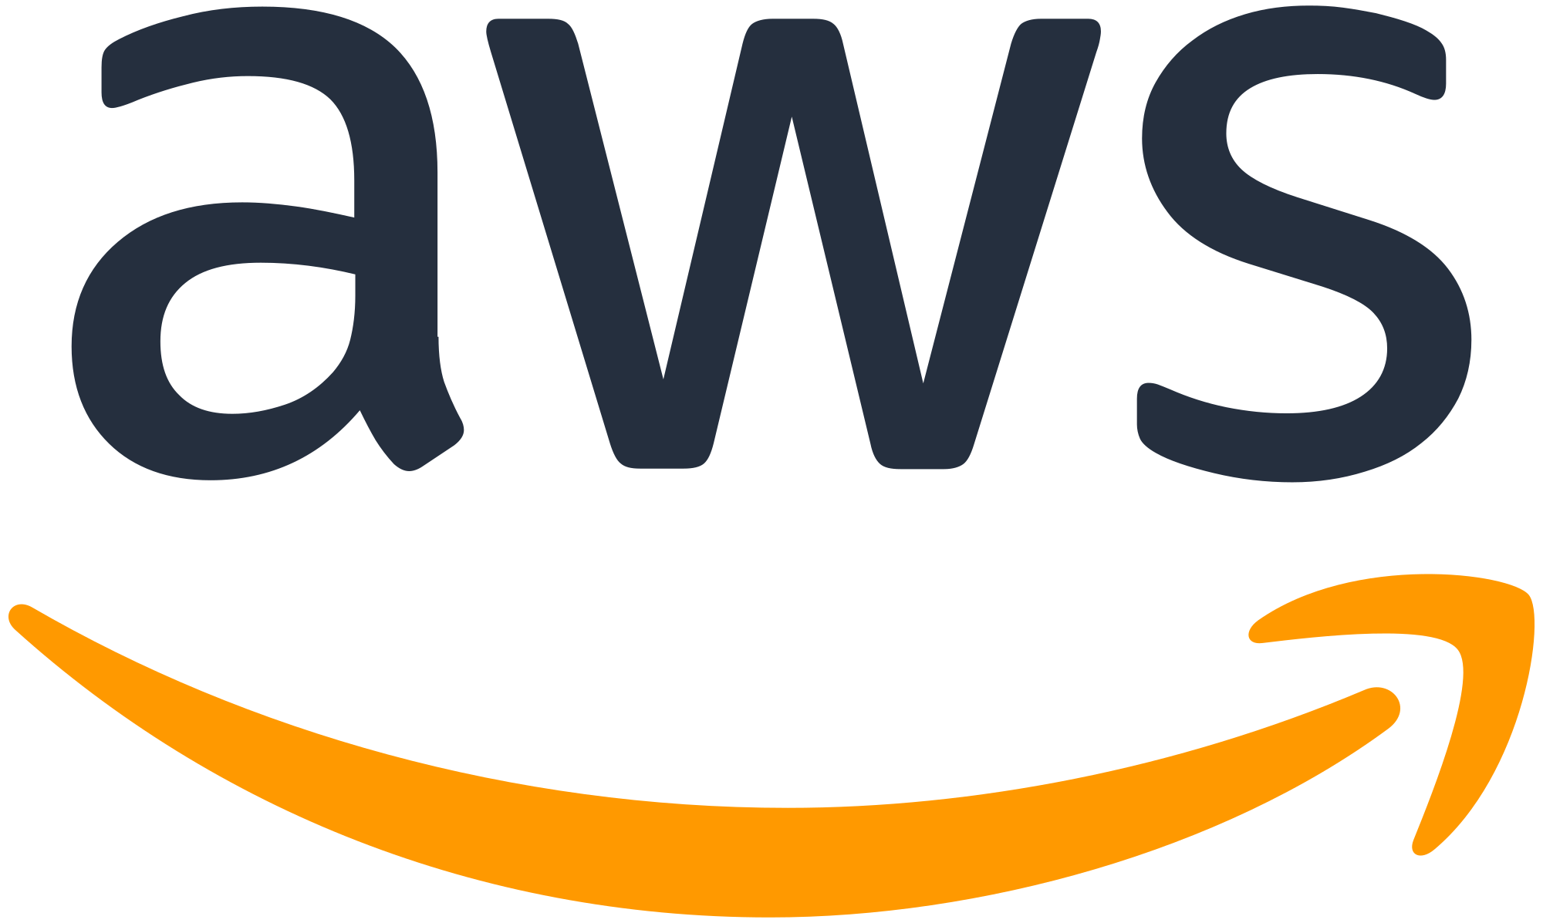
Clouds and Cloud Data Services
Private Cloud
Cloud Analytics
Cloud Insights
Cloud Controls
NetApp Kubernetes Service
OnCommand Cloud Manager
OnCommand Cloud Manager
Data Services
SaaS Backup
SaaS Backup
SaaS Backup
Cloud Tiering
Cloud Sync Service
Cloud Storage
Azure NetApp Files
Cloud Volumes Service
for Google Cloud Platform
Cloud Volumes Service
for AWS
Cloud Volumes ONTAP
Cloud Volumes ONTAP
Notes:
Instructor Notes
Student Notes
NetApp cloud data services are available for all major public cloud service providers and for on-premises private clouds. Availability of a particular service in a particular cloud depends on the use case and maturity of the service.
Cloud Storage
Cloud Volumes ONTAP is supported on Azure and AWS.
Cloud Volumes Service is available for AWS and Google Cloud Platform.
Azure NetApp Files is available exclusively for Azure.
Data Services
Cloud Sync service is available for all these clouds.
SaaS Backup is available for Azure, AWS, and private clouds.
Cloud Tiering is available as a SaaS offering to tier data from on-premises to the cloud and is only available for AWS. This product is not the same as data tiering for Cloud Volumes ONTAP, which is available for both AWS and Azure.
Cloud Controls
OnCommand Cloud Manager, which is primarily used for Cloud Volumes ONTAP, is also supported on Azure and AWS.
NetApp Kubernetes Service is available for all these clouds.
Cloud Analytics
Cloud Insights is available for all these public clouds.
As service offerings are added and availability is expanded, this map changes. Cloud Central provides the most current information.

Slide 18
Cloud Storage
Cloud Analytics
Cloud Insights
Cloud Controls
OnCommand Cloud Manager
APIs
NetApp Kubernetes Service
Data Services
Cloud Sync Service
Cloud Tiering
Cloud Secure
SaaS Backup
Cloud Backup Service
Cloud Storage
Cloud Volumes Service
Azure NetApp Files
Cloud Volumes ONTAP
Data Location
Private or Public Cloud
AWS | Google Cloud | Azure
SaaS Application
Office 365 | Salesforce
On-Premises
Data Center | Service Provider
Notes:
Instructor Notes
We will talk about the Cloud Storage in this section.

Slide 19
Cloud Volumes ONTAP

Slide 20

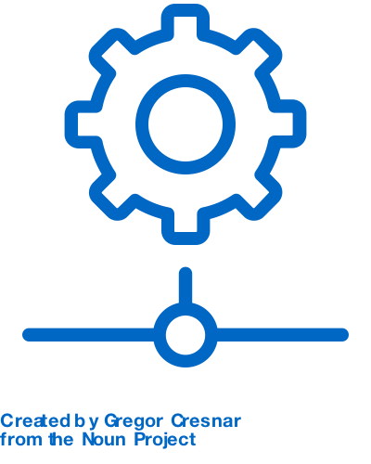
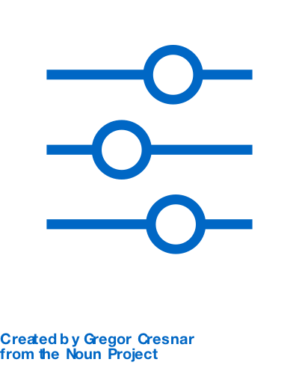
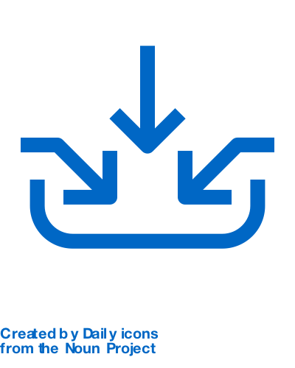
Cloud Volumes ONTAP
Data Control. Cost Efficiency. Business Continuity.
Enterprise data and storage management running natively in the cloud
Built-in storage efficiency to reduce costs
Deduplication, compression, thin provisioning, and cloning
Preconfigured to match your workload requirements
Deduplication, compression, thin provisioning, and cloning
Best for:
Moving applications to the cloud months or years faster
Automating development and testing for faster time to market
Ensuring business continuity across IT environments with a data center in the cloud
Ability to synchronize and manage both in-cloud and on-premises data
Single management console
Multiple protocols that public clouds do not offer
NFS, SMB, and iSCSI
Notes:
Instructor Notes
Amazon Elastic File System (Amazon EFS) is the first native NFS service on AWS, but it has some limitations:
Support for only NFSv4
Limited snapshot capabilities
Limited number of file systems per account
Complex to scale
NetApp Cloud Volumes adds the following:
Support for NFSv3, NFSv4, CIFS/SMB (~80% of enterprise file data is on NFSv3)
Native snapshots
Predictable performance based on SLAs (2-ms latency)
Built-in NetApp reliability, availability, and security
More than 25 years of experience in developing solutions and contributing code to NFS

Slide 21
Cloud Volumes ONTAP
What is it?
Cloud Volumes ONTAP is a full-fledged version of ONTAP that is running natively in AWS or Azure.
It consumes native cloud storage.
It enables a cloud-first strategy.
Notes:
Instructor Notes
Student Notes
Cloud Volumes ONTAP software is available on the AWS and Azure marketplace:
Enables high availability for applications
Supports storage efficiency and replication technologies
Is available on a pay-per-use or licensed model
Is simple to launch and operate through a GUI and an API
Is a virtualized ONTAP that is running in the public cloud as a virtual machine or instance
Is highly available and uses and manages Elastic block storage (EBS) /Virtual Hard Disk that is provided by AWS and Azure
Uses storage efficiency and SnapMirror software for data migration
Is available in all major AWS regions and is quick and easy to deploy

Slide 22
Cloud Volumes Service

Slide 23


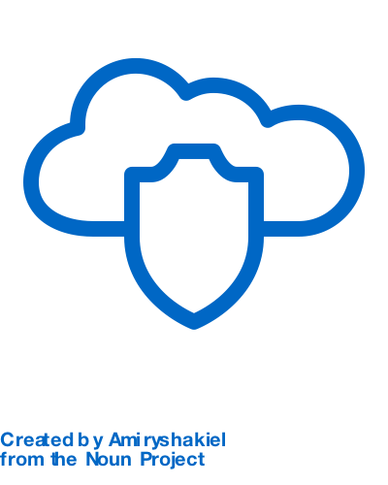
Cloud Volumes Service
Cloud-Native File Services
A fully managed, API-driven cloud-native file storage service that enables application deployment in the cloud and speeds application development
Deploy any workload that requires file services in the cloud
Even legacy applications, maximum agility
Acquire a subscription
To shift expense from capital expenditures (capex) to operational expenditures (opex)
Best for:
File-based workloads that benefit from cloud services
Legacy applications that have not been moved to the cloud because of cloud limits
Analytics workloads that require cloud storage
Secure and protect data
No application performance effect

Slide 24
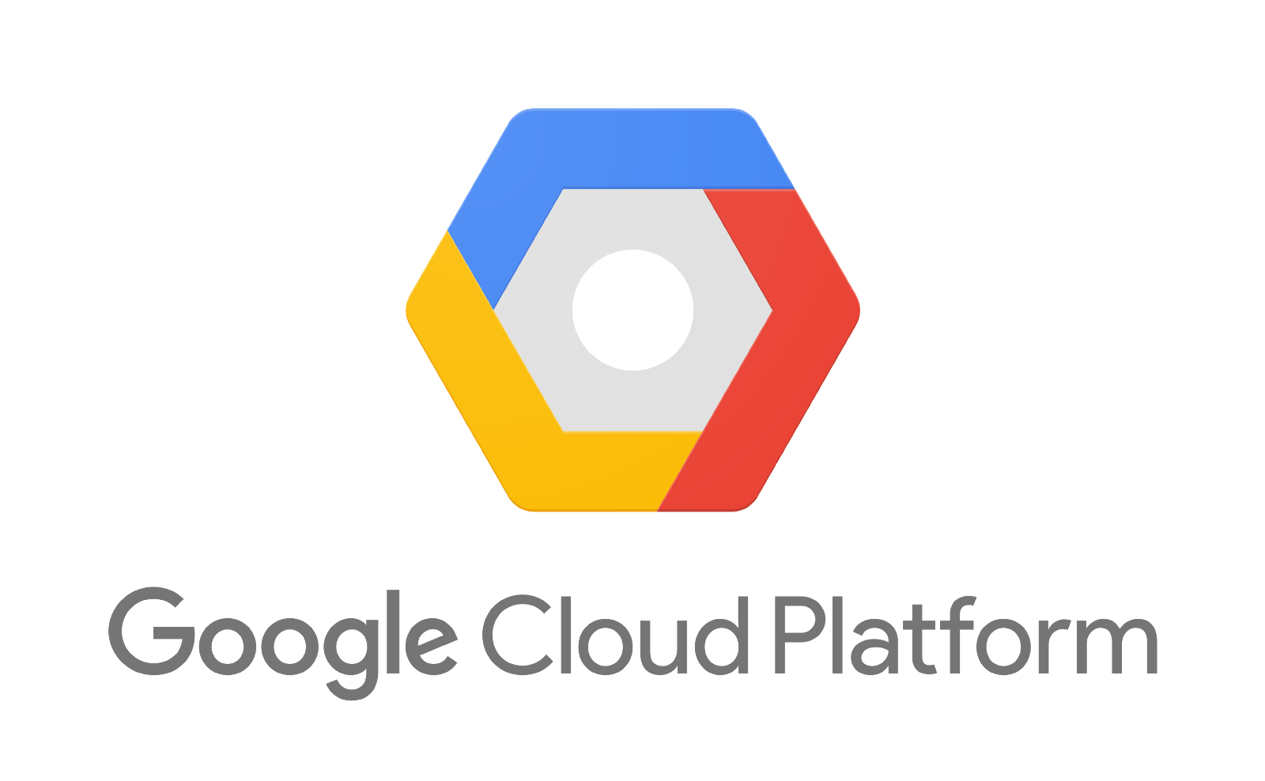
Cloud Volumes Service
Available in major hyperscalers
NetApp Cloud Volumes Service for AWS
NetApp Cloud Volumes Service for Google Cloud Platform
Notes:
Instructor Notes
NetApp Cloud Volumes Service for AWS: NetApp provides this service via a market place subscription. Once the customer is subscribed, they have the url to login to the UI of the CVS for AWS. The Customer can then create and manage cloud volumes. The backend infrastructure is maintained by NetApp.
NetApp Cloud Volumes Service for Google Cloud Platform: Similar to AWS offering. But the UI is integrated with the GCP platform. So Volumes can be created by subscribers in the context of a project in GCP.

Slide 25
File Services
In Microsoft Azure
Azure NetApp Files
Notes:
Instructor Notes
Azure NetApp Files:
Special partnership with Azure. The back-end infrastructure is within Azure Data Centers.
Customers subscribe to the service via marketplace and the UI is integrated with the Azure portal.

Slide 26

Managing Cloud Storage
Cloud Volumes ONTAP versus Cloud Volumes Service
Provider Managed
Customer Managed
Provides fully managed cloud services powered by NetApp
Requires little storage management knowledge
Provides cloud services that use familiar and reliable data management software
Requires some basic ONTAP storage management knowledge
Notes:
Instructor Notes
Student Notes
One consideration that should not be overlooked is the skills that are required to manage the storage.
Some organizations might have storage administrators, or application administrators that perform storage administration. Other organizations might not have those resources available. For example, a developer might simply need a volume to store application data on, without the costs associated with hardware or IT. With a NetApp-managed service like Cloud Volumes Service or Azure NetApp Files, the developer achieves that goal with all the robust features of ONTAP software.
For other organizations with skilled resources, Cloud Volumes ONTAP might be more desirable. Alternatively, the organization might use a mix of both types, depending on the situation.

Slide 27
Moving to simplify and scale management tasks
ONTAP FAS/AFF
ONTAP Select
Cloud Volumes ONTAP
Cloud Volumes Service
Mount Volumes
Mount Volumes
Mount Volumes
Mount Volumes
Provision Volumes
Provision Volumes
Provision Volumes
Provision Volumes
Provision Multi-tenancy
Provision Tenant
Provision Tenant
Provision Multi-tenancy
Provision Aggregates
Provision Aggregates
Provision Aggregates
Provision Aggregates
Configure Cluster
Configure Cluster
Configure Cluster
Configure Cluster
Rack System
Install Software
Deploy Software
Rack System
Receive System
Receive System
Receive System
Receive System
Place Order
Place Order
Place Order
Place Order
Plan Capacity
Plan Capacity
Plan Capacity
Plan Capacity
Manage Performance
Manage Performance
Manage Performance
Manage Performance
Manage ONTAP Upgrades
Manage ONTAP Upgrades
Manage ONTAP Upgrades
Manage ONTAP Upgrades
Manage Hardware FRU
Manage Hardware FRU
Manage Hardware FRU
Manage Hardware FRU
Performance
Low
Med
High
Low
Med
High
Low
Med
High
Low
Med
High
Customer managed
NetApp managed
Not needed

Slide 28
Cloud Data Services
Cloud Analytics
Cloud Insights
Cloud Controls
OnCommand Cloud Manager
APIs
NetApp Kubernetes Service
Data Services
Cloud Sync Service
Cloud Tiering
Cloud Secure
SaaS Backup
Cloud Backup Service
Cloud Storage
Cloud Volumes Service
Azure NetApp Files
Cloud Volumes ONTAP
Data Location
Private or Public Cloud
AWS | Google Cloud | Azure
SaaS Application
Office 365 | Salesforce
On-Premises
Data Center | Service Provider
Notes:
Instructor Notes
We will look at the various Cloud Data Services in this section

Slide 29
Cloud Sync Service

Slide 30

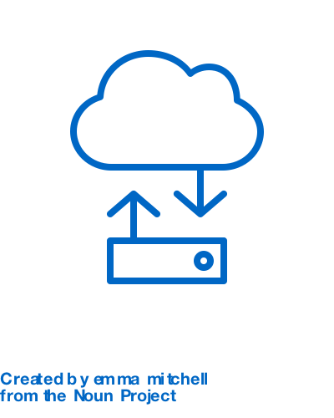

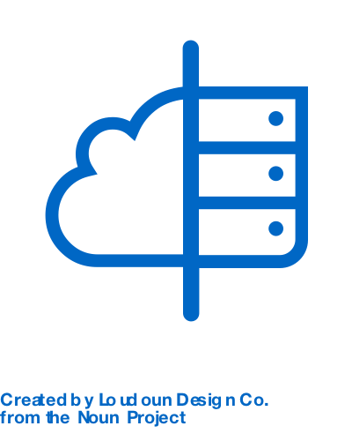
Cloud Sync Service
Secure, fast, automated data synchronization
Automate data migration processes, on-premises or to the cloud
Continuous, automated data synchronization
Extremely fast data movement compared to other synchronizing solutions that only move deltas
Best for:
Rapid and secure data migration and synchronization across any source and target
Continuous synchronization of large workloads while maintaining immediate data access
Onboard cloud environments converting and copying your file-based datasets to the public cloud of your choice
Delivery assurance based on built-in data protection
Secure data storage and transport with support for VPN and Virtual Private Cloud
Flexible on-demand consumption
Ability to purchase directly or from the AWS marketplace, licensed or pay-as-you-go model
Ability to bring your data center and the cloud together
Ability to realize the power of the Data Fabric with the ability to get your data where you want, when you want, and in any format
Notes:
Instructor Notes
Data is critical to our success.
Hybrid cloud requires a nearly constant data transport model.
How to do this efficiently, securely and in a cost-effective way.

Slide 31
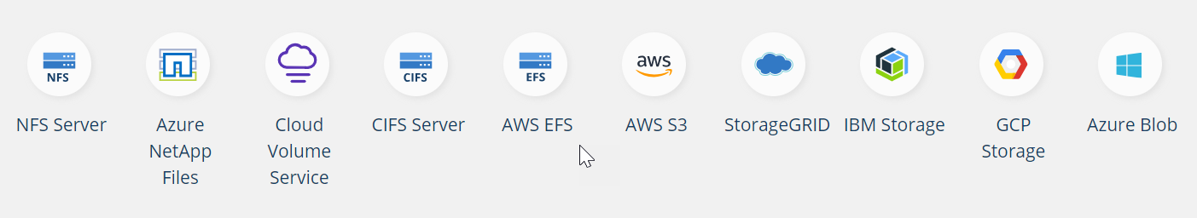
Cloud Sync Service
Synchronize on-premises and cloud storage NAS and object stores
Source and Target
Notes:
Instructor Notes
synchronization of data between on-premises storage and cloud storage NAS and object stores

Slide 32
Ways to Use Cloud Sync Service
Run analytics services in the cloud by using Elastic Map Reduce, Redshift, Insights, and so on
Create data lakes in Amazon Simple Storage Service (Amazon S3 or S3)
Synchronize data that was “born in the cloud” to your private cloud
Create data migration to S3 from Cloud Volumes ONTAP environments
Create data migration to the cloud volumes

Slide 33
Cloud Tiering
Preview Mode

Slide 34
What Is Cloud Tiering?
SaaS offering based on NetApp FabricPool technology
Intelligent tiering of cold data from on-premises AFF systems to object storage in the cloud
Hot data can be cost efficiently maintained in high-performance storage in the data center.
When the cold data is needed again, the service automatically and seamlessly brings it back to the high-performance tier.
Notes:
Instructor Notes
Cloud Tiering is available as a SaaS offering to tier data from on-premises to Cloud and is only available for AWS at this point. This is not the same as Data tiering for CVO that is available for both AWS and Azure.
Student Notes
Cloud Tiering
Reduce storage costs by automatically tiering infrequently used data to object storage in the cloud. Cloud Tiering enables you to provide high-performance storage for a larger set of applications at a lower cost.
Key Features
Lower Costs
Tier most of your data to low-cost object storage in the cloud
High Performance
Retain high performance for your frequently used data
Storage Agility
Pay for only the cloud object storage that you consume
Resources Optimization
Make high-performance storage available for more workloads
Smart Management
Experience automatic, seamless transfers between the performance and cloud tiers
Configurable Policies
Modify cooling periods and tiering policies according to your data requirements

Slide 35
SaaS Backup

Slide 36

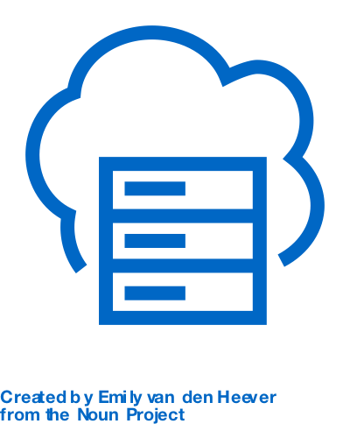
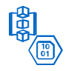

SaaS Backup
SaaS Backup for Microsoft Office 365 and SaaS Backup for Salesforce
Guard your SaaS data from threats or accidental deletion
Provides a secure, web-based SaaS offering
Microsoft Office 365 or Salesforce accounts with encryption for data at rest and in flight
Best for:
Extending Office 365 and Salesforce data protection with granular backup and restore
Meeting regulatory compliance with long-term retention and choice of backup targets
Protecting and recovering all email, calendar, contacts, tasks, site collections, lists, and files
Protects and manages backups
Microsoft Exchange Online, Microsoft OneDrive for Business, SharePoint Online, Groups, Teams, and Salesforce
Uses cloud or on-premises backup targets
NetApp-managed S3 or Azure Blob accounts or Bring Your Own Storage (BYOS) cloud or on-premises storage
Now supports shared mailboxes for Microsoft Office Exchange Online
Automated discovery and protection

Slide 37

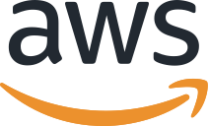
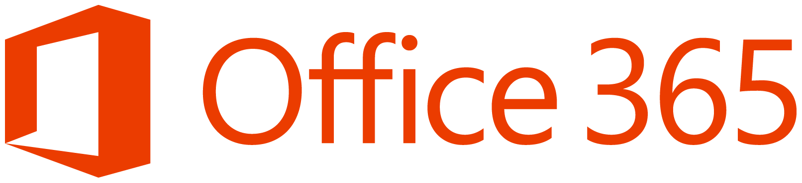

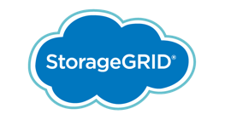


SaaS Backup
Overview
SaaS Backup
Backup Storage
Backup
Restore
SaaS Providers
Users
Notes:
Instructor Notes
The NetApp SaaS Backup service is a web-based SaaS offering that backs up SaaS data to Amazon S3 storage, Microsoft Azure Blob storage, or StorageGRID object storage. If data is deleted accidentally or maliciously, SaaS Backup service can easily restore the data.
SaaS Backup protects backup data in transit with Secure Sockets Layer (SSL) encryption and data at rest with 256-bit Advanced Encryption Standard (AES) object-level encryption.

Slide 38
SaaS Backup for Microsoft Office 365
Choosing backup storage
NetApp SaaS Backup
(managed service)
NetApp SaaS Backup
(managed storage)
NetApp SaaS Backup
Bring-your-own-storage (BYOS)
Notes:
Instructor Notes
With SaaS Backup, you can back up your data to the location of your choice. You need to decide what type of storage that you want to use to back up your data.
Either enable the NetApp SaaS Backup service to store your backup data in its AWS or Azure multitenant cloud repository or bring your own storage (BYOS) location. When you bring your own storage, you can choose your own S3 bucket or Azure Blob Storage. If you require on-premises-based targets, you can bring your own NetApp StorageGRID object storage.

Slide 39
Cloud Secure
Preview Mode

Slide 40
What Is Cloud Secure?
Identifies malicious data access and compromised users
Provides centralized visibility and control of all corporate access across hybrid cloud environments
Ensures that security and compliance goals are met
Notes:
Instructor Notes
How The Product Works
Analyze Entities Across Data Fabric
To accurately identify breaches, every user activity, across on-premises and hybrid cloud environments, is captured and analyzed.
Form Communities
To understand risky user behavior, it’s important to identify the user’s true 'virtual' working communities. Cloud Secure forms communities of users based on common file access patterns and establishes a baseline of a community’s typical user.
Detect Anomalies & Take Action
Cloud Secure uses advanced machine learning algorithms to automatically uncover unusual data activity. It automatically updates protection policies and permissions to restrict access, stopping actual threats before they become breaches.

Slide 41
Cloud Backup Service
Preview Mode

Slide 42
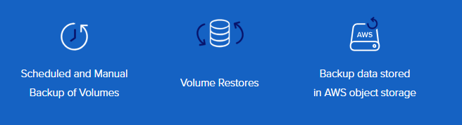
Cloud Backup Service
Fully managed data protection service for Cloud Volumes Service
A fully managed data protection service for NetApp Cloud Volumes Service
Notes:
Instructor Notes
Protects cloud volumes in AWS to AWS object storage
Can perform scheduled and manual backup of cloud volumes
Can restore volumes from S3
Use Cases
Long term archive, retention, data protection supplementing snapshots
Protects offsite in case of outage, disaster recovery, threats and attacks
Capabilities:
Fully managed multitenant micro-service that is delivered and managed by NetApp
Scheduled and manual backup of a volume and volume restore
Backup data that is stored in object storage form in a hyperscaler object service
Integrated UI look and feel with Cloud Volumes to perform self-service operations
Billed on a metered basis and integrated with hyperscaler billing
Simple
Fully managed self-service data protection at hyperscaler scale
Efficient
Storage efficient operations that lower lifecycle costs of performing data protection
Trusted
Capabilities that take advantage of over 25 years of file services platform innovation leadership
Secure
End-to-end data security that reduces security and compliance risks in the cloud

Slide 43
Cloud Backup Service
Integrated with NetApp Cloud Volumes Service for AWS (beta)
Future possible feature in the following:
Azure NetApp Files
Cloud Volumes Service for Google Cloud Platform

Slide 44


Hands-On Activity
Module 1: Data Fabric Overview
Exercise 1:
Control Cloud Resources with Windows PowerShell and the CLI
This exercise requires approximately 30 minutes.
Notes:
Instructor Notes
You can control cloud resources from on-prem, using PowerShell and CLI. These can be leveraged into an automated process. APIs are covered later. This exercise helps break up the length of this first module and prepares you for later exercises.
Student Notes

Slide 45

ACTION: Share Your Experiences
Roundtable questions for the exercise
Which credentials do you supply to run the AWS CLI and Windows PowerShell commands?
Can you run all Windows PowerShell commands in the library? How can you limit a user from running certain commands?
45
Notes:
Instructor Notes
Basic point of these questions is to focus back on the IAM user and roles. For Azure we are using the root login information.
Student Notes
If you encounter an issue, notify your instructor immediately so that it can be resolved promptly.

Slide 46
Cloud Controls
Cloud Analytics
Cloud Insights
Cloud Controls
OnCommand Cloud Manager
APIs
NetApp Kubernetes Service
Data Services
Cloud Sync Service
Cloud Tiering
Cloud Secure
SaaS Backup
Cloud Backup Service
Cloud Storage
Cloud Volumes Service
Azure NetApp Files
Cloud Volumes ONTAP
Data Location
Private or Public Cloud
AWS | Google Cloud | Azure
SaaS Application
Office 365 | Salesforce
On-Premises
Data Center | Service Provider

Slide 47
OnCommand Cloud Manager

Slide 48

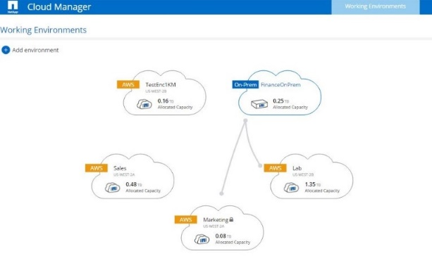
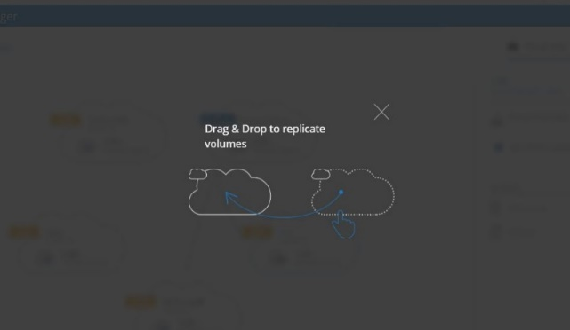
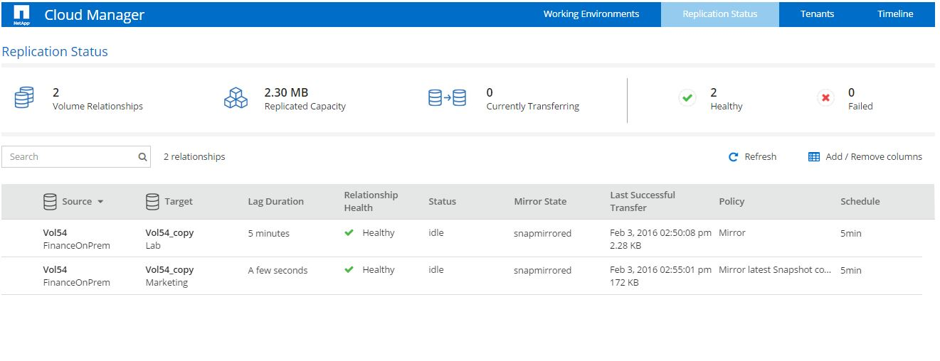
OnCommand Cloud Manager
Simple deployment and management suite for Cloud Volumes ONTAP
Enjoy an intuitive UI
Deploy Cloud Volumes ONTAP instances in minutes
Manage your data replication from the data center to the cloud
Experience data security choice through NetApp managed encryption
Use hybrid environments that include Cloud Volumes ONTAP and physical ONTAP systems
Notes:
Instructor Notes
Cloud Manager can now automate the deployment of NetApp Trident on a single Kubernetes cluster, so you can use Cloud Volumes ONTAP as persistent storage for containers. For more information, see
https://docs.netapp.com/us-en/occm/reference_new_occm.html

Slide 49
OnCommand Suite of Tools
Simple deployment and management suite for ONTAP software in private data centers
System Manager
Unified Manager
Workflow Automation
API Services
Insight
Notes:
Instructor Notes
This slide lists other OnCommand Suite of products used in private data center environment.

Slide 50
APIs

Slide 51
API Documentation
LEARN HOW TO AUTHENTICATE
x
NetApp Cloud Central
View API Documentation
Integrated hub for development information, help, documentation and launching services from NetApp Cloud Central.
Cloud Volumes Service for AWS
View API Documentation
A cloud native file service that provides NAS volumes over NFS and SMB with all-flash performance.
Cloud Volumes ONTAP
View API Documentation
A powerful, cost-effective and easy-to-use solution for enterprise cloud storage.
Cloud Sync
View API Documentation
NetApp’s service for rapid and secure data synchronization.
Notes:
Instructor Notes
The cloud, as you probably already know, is controlled using application programming interfaces (APIs), whether through automation tools, orchestration tools, scripting, or swagger.
Information on using the API for cloud data services, [1] including the NetApp Cloud Central Services API itself, can be found on Cloud Central.

Slide 52
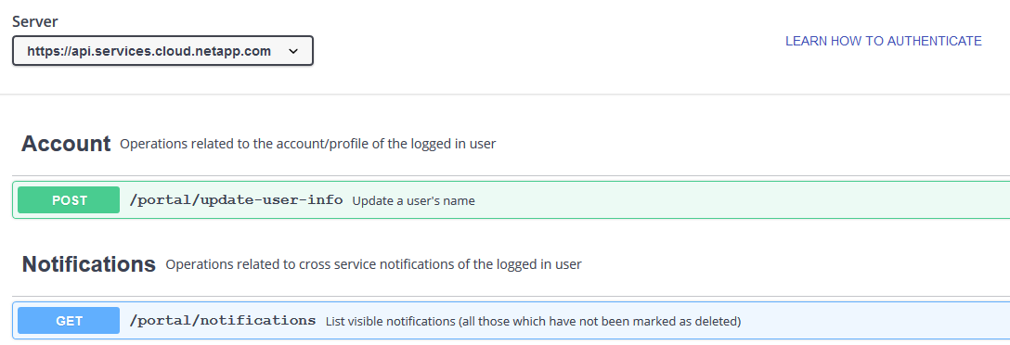
NetApp Cloud Central API
Notes:
Instructor Notes
This is an example of the NetApp Cloud Central Services API documentation. The document uses swagger, which is an open source software framework used by developers to design, build, document, and consume RESTful Web services.
The NetApp Cloud Central Services API is meant to be used to perform basic operations on a user's account unrelated to any specific service. Generally speaking, anything that can be done through the Dashboard User Interface can also be done through this API.
[1] Expanding the POST command enables you to view the [2] parameters, [3] request body and [4] responses. You can also [5] Try it out, which is standard in most swagger documentation.

Slide 53
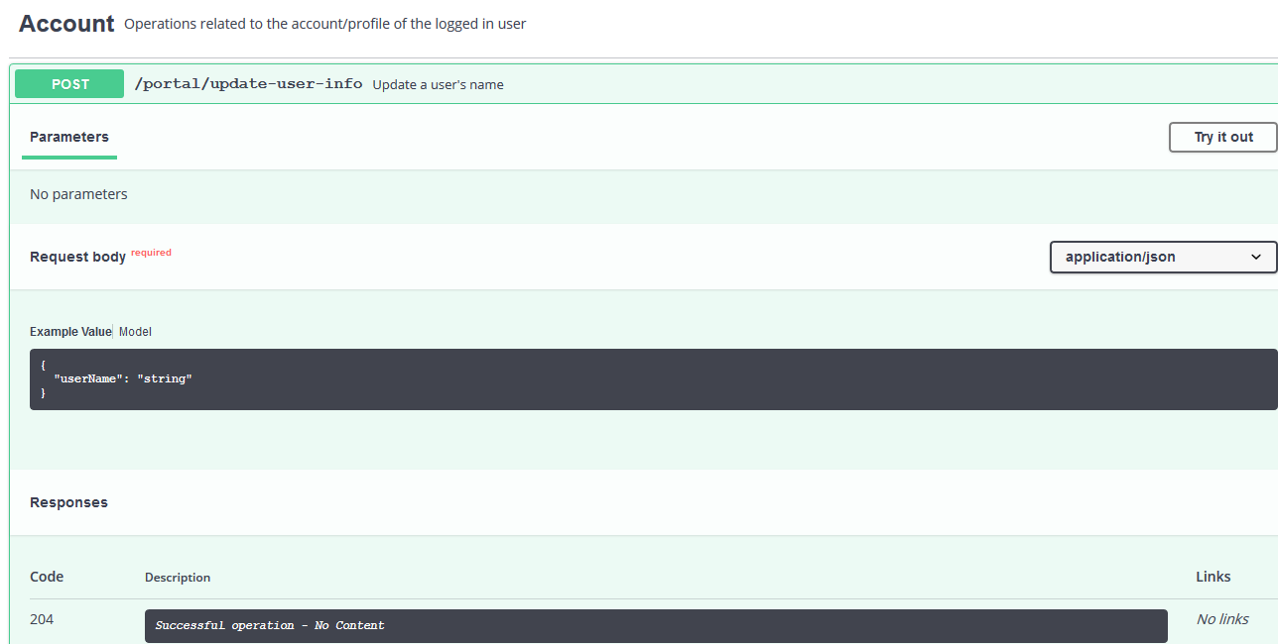
NetApp Cloud Central API
Expanding the POST command
Notes:
Instructor Notes
This is an example of the NetApp Cloud Central Services API documentation. The document uses swagger, which is an open source software framework used by developers to design, build, document, and consume RESTful Web services.
The NetApp Cloud Central Services API is meant to be used to perform basic operations on a user's account unrelated to any specific service. Generally speaking, anything that can be done through the Dashboard User Interface can also be done through this API.
[1] Expanding the POST command enables you to view the [2] parameters, [3] request body and [4] responses. You can also [5] Try it out, which is standard in most swagger documentation.

Slide 54
NetApp Kubernetes Service

Slide 55


Concepts
Containerization
Orchestration
Notes:
Instructor Notes
To understand the NetApp Kubernetes Service, We need to talk about Kubernetes which is container orchestrator.
To understand container orchestrators, we need to understand containerization technology. So we will talk about both before discussing NKS.

Slide 56
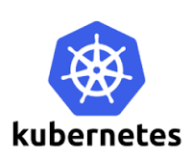

Containerization
Virtualization
Containerization
Virtual Machine
Virtual Machine
Orchestration Tools
App 1
App 2
Container
Container
Bins/Libs
Bins/Libs
App 1
App 2
Guest OS
Guest OS
Bins/Libs
Bins/Libs
Hypervisor
Containerization Software
Host OS Software
Host OS Software
Host OS Kernel
Host OS Kernel
Infrastructure
Infrastructure
Notes:
Instructor Notes
Virtualization technology allows us to virtualize the underlying hardware so that we can have multiple virtual machines running different OS all sharing the same hardware. This gives us better utilization of the underlying hardware. But each VM consume more disk space because each VM is heavy.
Containerization, also known as operating-system-level virtualization, is a technology that enables multiple isolated user-space instances, called containers, to run in a shared environment. All the application containers running on top of the containerization software share the same OS kernel running on the server. The container software (like Docker) can run any distribution of Linux like Debian, Fedora, SUSE or CentOS etc on top of the same underlying kernel. Each version of the container software has only a thin layer of OS software that enables it to run on top of the OS kernel. Of course you will not be able to run a windows based container on top of this Linux OS on this host. For that you will run Docker on a windows server.
Is that a disadvantage – Not being able to run another OS on the same host? The answer is no!
Unlike hypervisors, containerization software is not meant to virtualize and run different OS and kernels on the same hardware. Main purpose of container software (docker) is to containerize applications with their libraries and dependencies and to run them.
Containers are light weight because they don’t have the full OS. They boot up faster. But container (docker) has less isolation as more resources are shared between containers like the OS kernel. In comparison, VMs are completely isolated from each other.

Slide 57

Container Orchestration
Host
Host
Host
Host
Orchestration
Notes:
Instructor Notes
We have the application packaged as containers. But how do we run them in production? How can we manage the dependencies of one container with others? (e.g. database or messaging services or other backend services). What if the number of users increase and you need to scale your application? You would also like to scale down when the load decreases.
Container Orchestration is the process of automatically deploying and managing containers.

Slide 58
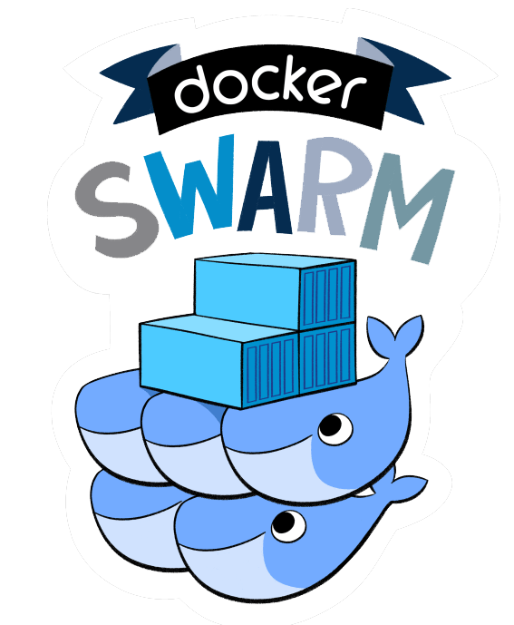
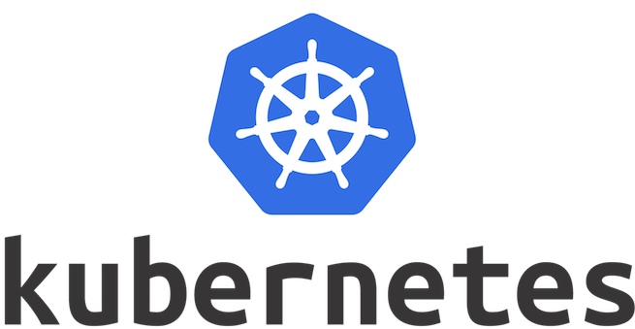
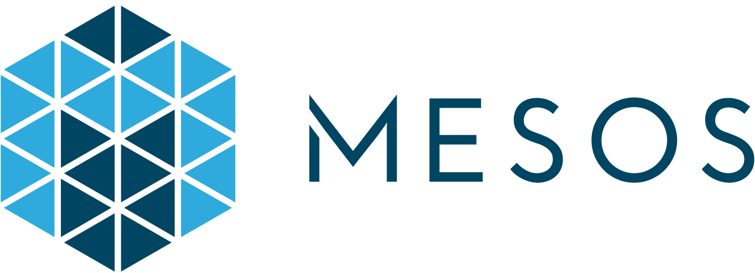
Container Orchestration Technologies
Deploy and Configure
Fault Isolation and Healing
Security
Upgrades
Scaling Up and Down
Notes:
Instructor Notes
There are many different container orchestrators.
Docker Swarm from Docker
Mesos from Apache
Kubernetes – an open source container orchestration platform
Let us discuss very briefly about the Kubernetes architecture

Slide 59
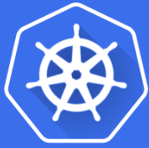
Kubernetes Architecture
Image Registry
Optional Add-ons
Pod
Pod
Pod
Pod
Pod
UI
Node 1
Pod
Kubernetes Master
Optional Add-ons
API
CLI
Node 2
Optional Add-ons
Node n
Notes:
Instructor Notes
Kubernetes is now supported on all public cloud service providers like GCP, Azure and AWS and the kubernetes project is one of the top ranked projects in Github.
Kubernetes is an opensource automation platform. Software developers often design their applications as containers and deploy them on compute nodes and provide storage resources for their applications. They can do this manually if they are only dealing with a few containers. But often times, they need to scale the resources of the containers. In order to do this in a repeatable, error-free manner, they need a simple way to automate the process.
Kubernetes is a platform for deploying and managing containers in an automated fashion.
Kubernetes coordinates a cluster of nodes that work together as a single unit.
A Kubernetes Cluster is a set of compute nodes and the storage resources.
There is a master node and multiple worker nodes.
Each node has Kubernetes and Container software installed.
Master node:
The master is responsible for managing the cluster.
Worker nodes:
containers will be scheduled to execute on worker nodes. Each worker node has a container engine (Docker is common) and the Kubernetes node agent, or kubelet installed.
POD:
A pod can contain a set of containers that are deployed and scaled together. POD allows these containers to share resources (IP addresses, file systems etc). Minimum unit of deployment in a kubernetes cluster.
So now application developers design their applications using pods. Once the pods are ready, the master node is configured with the pod definitions and how many PODS need to be deployed.
From that point kubernetes is in control.
It takes the pods and deploys them on the worker nodes.
If a worker node goes down, it takes the pod and puts it on a functioning worker node.
Application developers don’t have to worry about the complexity of managing containers any more.
K8s was originally developed by Google. Then it was donated to the Cloud Native computing foundation.
It is a large and complex system for automating, deploying, scaling and operating application containers.

Slide 60





NetApp Kubernetes Service
A cloud-native managed service from NetApp
The industry’s first complete multicloud Kubernetes (K8s) control plane
Simple, uniform user experience from a single pane of glass
NetApp Trident dynamic storage provisioner for K8s clusters
Other optional cloud native solutions like Istio and Helm are pre-installed.
Data Center
Optional Add-ons
Notes:
Instructor Notes
So What is NetApp Kubernetes Service:
NKS enables you to treat the world as your cloud with a single pane of glass management. No one else can provide this for you because they are not cloud native.
NKS can provision, maintain, and do a proper lifecycle management of your K8S clusters no matter where they are running.(AWS, Azure or GCP). One of the advantages of NKS is that we provide a uniform experience across cloud providers.
Simplicity, NKS makes it very simple to deploy and manage your K8s clusters.
One of the hardest problem to solve for K8s, as reported on every single KubeCon, is and has been the storage, storage class and persistent volume claim. Our integration of Azure NetApp Files and Cloud Volumes Service and our CVO in AWS and Azure takes care of that automatically for you with Trident and provides you with unmatched flexibility of your underlying K8s storage. Since we are on all the hyperscalers (Azure, GCP and AWS), you can take advantage of the data management capabilities of ONTAP, like snapshots, clones, replication and migration.
NKS is the only K8s service that allows you to run K8s on your own instances on all the public clouds where you control the master node, or on-top of GKE, AKS or EKS where you don’t control the K8s master node.

Slide 61
NetApp Kubernetes Service
Capabilities
Pure upstream Kubernetes service.
You can federate K8s clusters across multiple hyper-scalers and on-premises.
NetApp Kubernetes Service is the only current K8s service that supports Graphics Processing Unit (GPU) containers.
ROI is delivered from a single developer to large enterprises.
Notes:
Instructor Notes
Pure upstream Kubernetes Service. We support the latest K8S release within a week
NKS is the only K8s service that allows you to run K8s on your own instances on all the public clouds where you control the master node, or on-top of GKE, AKS or EKS where you don’t control the K8s master node.
NKS fits everyone, from one developer to large enterprises with simple and transparent pricing model.
Some history:
Greenqloud (acquired by NetApp) wrote the Service Delivery Engine and the Application Lifecycle Management on Kubernetes, but they were always manually deploying and managing the Kubernetes clusters that they were running on all the hyperscalers. With the Stackpoint acquisition and the launch of NKS, they have moved to using that purely for the SDE deployments everywhere. (What used to take them 2-3 days standing up a new region on the public clouds. Now, with NKS, it takes them on average 23 minutes.)

Slide 62

NetApp Kubernetes Service at Cloud Central
Deploy a production-ready Kubernetes cluster in three clicks, when you want it, where you want it
Notes:
Instructor Notes

Slide 63

NetApp Kubernetes Service
1
Choose a provider
2
Configure the provider
3
Configure the cluster
Kubernetes cluster
Optional Add-ons
…
Docker
kubelet
Docker
kubelet
Docker
Notes:
Instructor Notes
NetApp Kubernetes Service makes cluster deployment simple, with three clicks:
First, choose your cloud provider.
Second, configure the provider.
Third, configure your Kubernetes cluster.
Additionally, you can select various add-ons to install which make managing the cluster easier. For example, Trident to manage Cloud Volumes and other popular Kubernetes add-ons like Istio and Helm.

Slide 64
Cloud Analytics
Cloud Analytics
Cloud Insights
Cloud Controls
OnCommand Cloud Manager
APIs
NetApp Kubernetes Service
Data Services
Cloud Sync Service
Cloud Tiering
Cloud Secure
SaaS Backup
Cloud Backup Service
Cloud Storage
Cloud Volumes Service
Azure NetApp Files
Cloud Volumes ONTAP
Data Location
Private or Public Cloud
AWS | Google Cloud | Azure
SaaS Application
Office 365 | Salesforce
On-Premises
Data Center | Service Provider

Slide 65
Cloud Insights

Slide 66








Cloud Insights
Innovate faster with insights across your application infrastructure stack
SaaS-based tool that monitors all your infrastructure assets
Specifically for cloud application infrastructures
Analyzes dynamic cloud infrastructure at scale and supports micro-services, containers and Kubernetes
Best for:
Monitoring cloud native applications that dynamically provision infrastructure through APIs
Rapidly finding problems and reducing mean-time-to-resolution (MTTR)
Optimizing cloud resources by understanding infrastructure relationships and usage
Preventing critical infrastructure issues before they affect customers
SaaS Development to get you up and running quickly
Uses agents to discover your infrastructure in minutes and begin monitoring
Advanced analytics
Provides proactive alerting, fast troubleshooting, and optimization of resources with recommended workload placements
Monitoring of all major vendors and cloud providers
Notes:
Instructor Notes
Cover points on the slide
Background Point Despite an increased focus on cloud cost management, only a minority of companies have implemented automated policies to optimize cloud costs, such as shutting down unused workloads or selecting lower-cost clouds or regions
According to RightScale 2018 State of Cloud report, Cloud users underestimate the amount of wasted cloud spend. Respondents estimate 30 percent waste, while RightScale has measured actual waste at 35 percent. This explains why cloud spend is a challenge for 76 percent of respondents to the same survey.

Slide 67






Monitoring Tools
OnCommand Insight
NetApp Cloud Insights
NetApp Active IQ
Location
Construct
Software license
Software as a service (SaaS)
Data collection built in to NetApp systems, analyzed by Active IQ in the cloud
Monitors
Cloud and on-premises multivendor resources and infrastructure
NetApp systems
Function
Monitoring and optimization for multivendor and multicloud infrastructure
Predictive optimization and support for NetApp systems
Reporting
Dashboard and Reports
Dashboard
Dashboard
Notes:
Instructor Notes
There are few tools you can use to gain insight about resources and infrastructure. We will compare three tools that appear similar, but have some unique features: [1] OnCommand Insight, [2] Cloud Insights and [3] Active IQ.
[4] One major difference between these products is where the product or service is installed or located.
[5] OnCommand Insight is a software product licensed to run on the customer’s on-premises systems.
[6] Cloud Insights is offered as Software as a Service (SaaS), so there are no install or licensing requirements.
[7] Active IQ is built in to every NetApp storage system to monitor the system. System information can be viewed via the web or mobile app.
[8] Another difference is [9] what can be monitored and [10] how that information is used.
[11] OnCommand Insight and Cloud Insights are used to monitor infrastructure, including both cloud and on-premises multi-vendor resources. The difference being, OnCommand Insight was designed to run on the customer’s on-premises systems, whereas Cloud Insights is specifically designed for today’s cloud-based infrastructure and deployment technologies. [12] However, both of these tools provide monitoring and optimizing capabilities.
[13] Active IQ provides predictive optimization and support for NetApp systems.
[14] The last difference we will cover is reporting capabilities. [15] While Cloud insights and Active IQ have excellent dashboards to view system information, [16] OnCommand Insight add best in class reporting capabilities.
[17] This lesson will focus on Cloud Insights.

Slide 68
Hands-On Activity
Module 1: Data Fabric Overview
Exercise 2:
Assess Azure and Amazon Web Services Environments
This exercise requires approximately 20 minutes.
Notes:
Instructor Notes
In this exercise students can use their own accounts or their assigned accounts. For assigned accounts the results will be empty but they can redo assessment at end of the class. Also we have some already existing outputs of Assessments with data in the CourseFiles folder.
Student Notes

Slide 69
ACTION: Share Your Experiences
Roundtable questions for the exercise
What types of issues can you discover with the Assessment tool?
69
Notes:
Instructor Notes
It finds issues like unused resources (unattached EBS volumes, unassigned EBS snapshots). And protection risks of how often snapshots are taken.
Student Notes
If you encounter an issue, notify your instructor immediately so that it can be resolved promptly.

Slide 70
Focus of this Course

Slide 71
Clouds and Cloud Data Services
Private Cloud
Cloud Analytics
Cloud Insights
Cloud Controls
NetApp Kubernetes Service
OnCommand Cloud Manager
OnCommand Cloud Manager
Data Services
SaaS Backup
SaaS Backup
SaaS Backup
Cloud Tiering
Cloud Sync Service
Cloud Storage
Azure NetApp Files
Cloud Volumes Service
for Google Cloud Platform
Cloud Volumes Service
for AWS
Cloud Volumes ONTAP
Cloud Volumes ONTAP
Notes:
Instructor Notes
The purpose of this slide is to show what we will focus in this course
We will discuss OnCommand Cloud Manager and in the lab, deploy it in AWS and configure it and use it to deploy Cloud Volumes ONTAP in AWS.
Reiterate that we will discuss Cloud Volumes ONTAP and Cloud Volumes ONTAP HA in AWS and Azure. We will deploy it in AWS in the labs.
We will use Cloud Sync to bring data from a CIFS Server in on-premises to S3 bucket in AWS.
We will discuss Cloud Volumes Service in AWS, GCP and NetApp Azure Files. Students will do labs using Cloud Volumes service in AWS.

Slide 72
Focus of Exercises
Enterprise Workloads
SaaS App Development
Disaster Recovery
Backup & Archive
File Services
Analytics
DevOps
Database
Cloud Volumes Service
Cloud Volumes ONTAP
SaaS Backup
Notes:
Instructor Notes
The purpose of this slide is to show what solutions we will implement in the labs.
We will implement disaster recovery using SnapMirror which requires a cost-effective cloud secondary copy that supports seamless and quick failover and failback.
We will bring data from on-premises CIFS server to the WS S3 bucket for use with Big Data and Analytics engine in the cloud
We will spin up Cloud Volumes in AWS that can be used for enterprise workloads, File Services and Database applications that require high performing storage in the cloud.
Student Notes

Slide 73

Module Review
The Data Fabric powered by NetApp provides customers with a shared set of secure data services so that they can manage, access, and protect data where it is needed most.
NetApp, as a data management company, provides many cloud data services for Data Fabric solutions to empower the cloud champions.
The OnCommand suite of management products enables management of data in a hybrid cloud environment.
You can use Windows PowerShell and role-based access control (RBAC) to automate and appropriately administer your hybrid cloud environment.
Notes:
Instructor Notes Data Fabric powered by NetApp provides customers with a shared set of secure data services so that they can manage, access, and protect data where it is needed most. They can respond and innovate faster and gain the freedom to make the best decisions for their businesses.
Student Notes

